Slide 1

Electrical Safety
Sunrise Services, LLC
8/31/2022

Slide 2
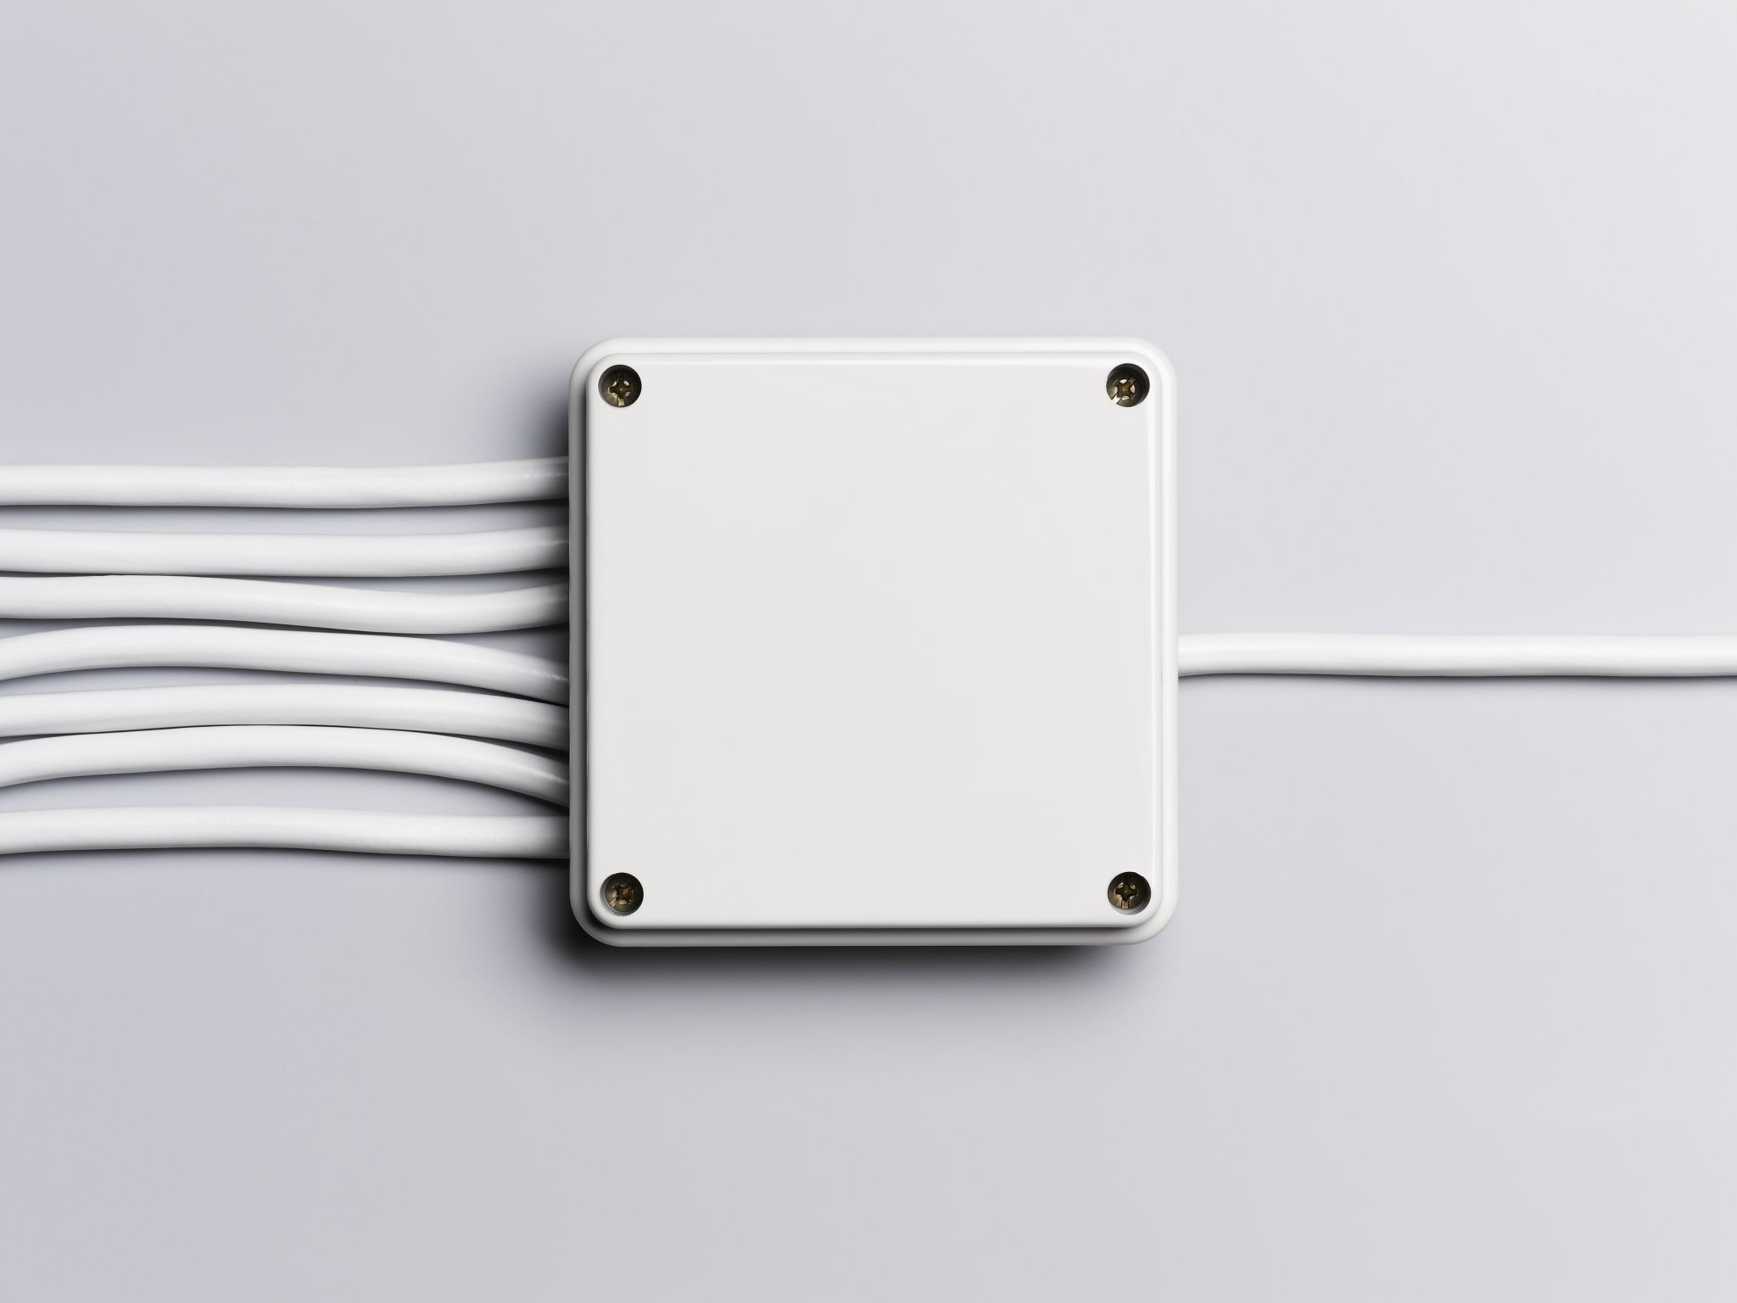
Electrical Safety
The hazards associated with electricity affect the majority of
workplaces. Whether you are in general industry, construction,
or even farming, electrical hazards are present. It is important
to be able to recognize the electrical hazards around you and
know how to mitigate them.

Slide 3
Electricity-Related Injuries
2020 126 Fatalities in the United States due to contact with electricity.
2,200 injuries that required days away from work.

Slide 4
Common Electrical Hazards
Overhead Powerlines
Underground Powerlines
Lightning
Faulty Equipment
Working on Energized Equipment
Improper Grounding
Damaged Insulation

Slide 5
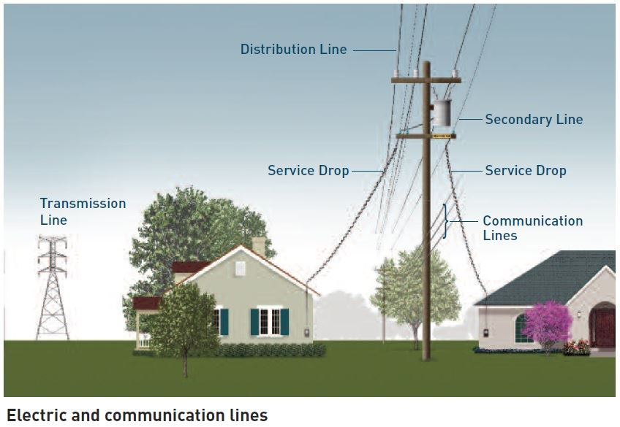

Slide 6
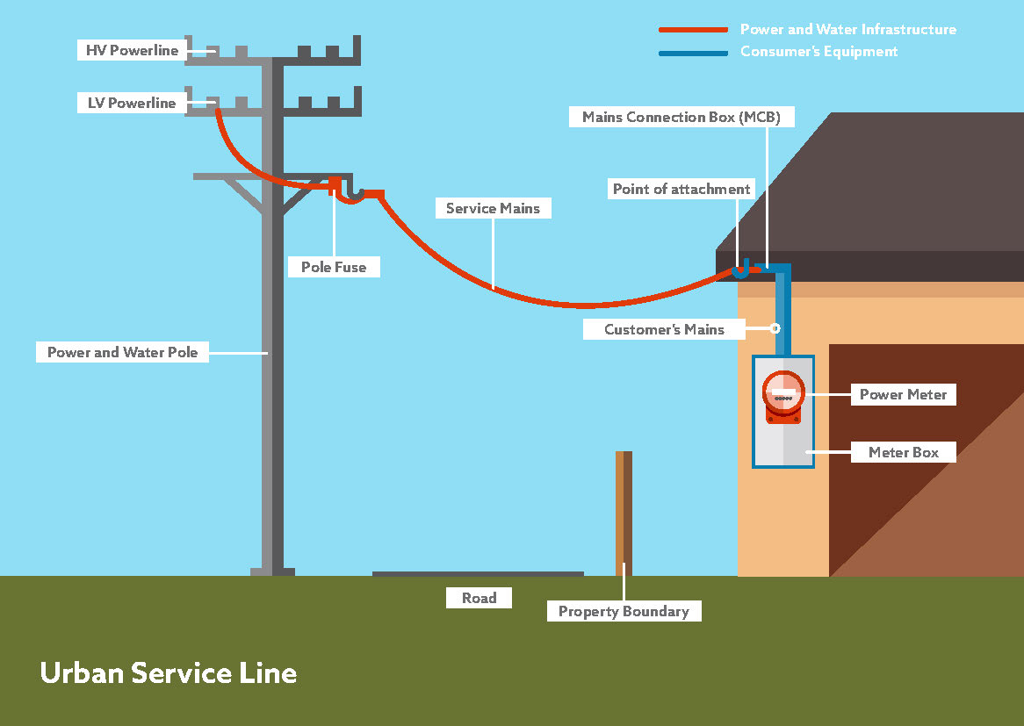
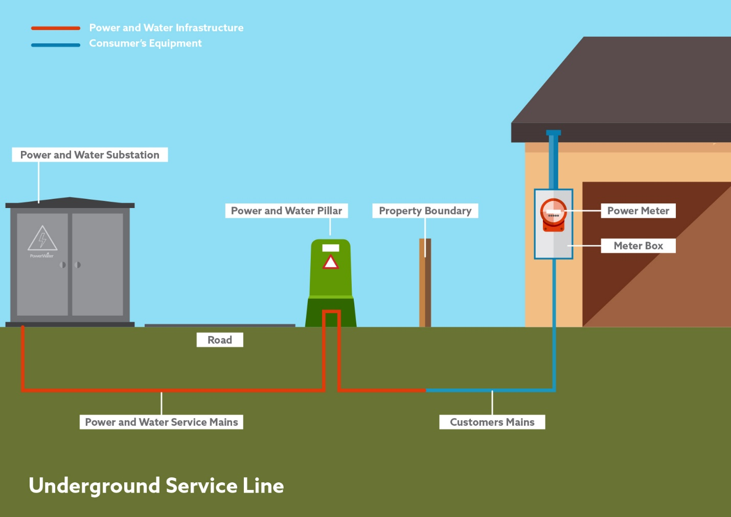

Slide 7
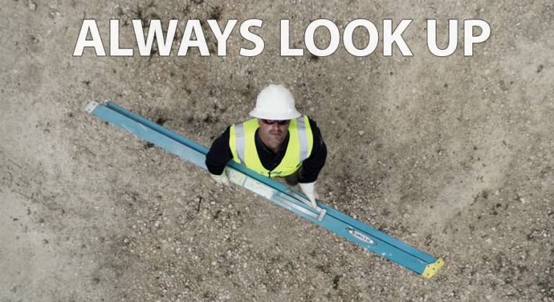
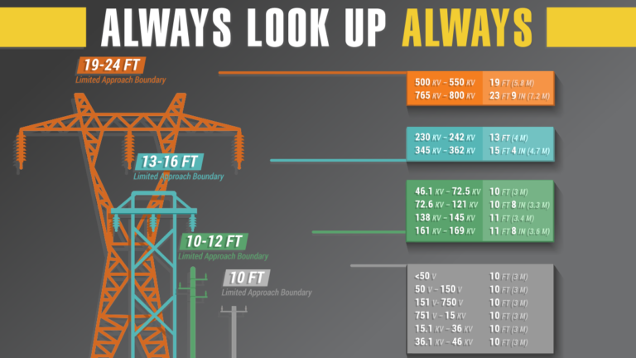
A safe working distance depends on the voltage of the power lines. Always maintain a distance of at least 10 feet from overhead lines and more than 10 feet if the voltage to ground is over 50 kilovolts (50,000 volts). The higher the voltage, the greater the distance that is needed between the lines and the workers.

Slide 8



































































































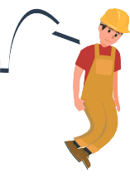






















8 8
Please share this free resource to save lives

Slide 9
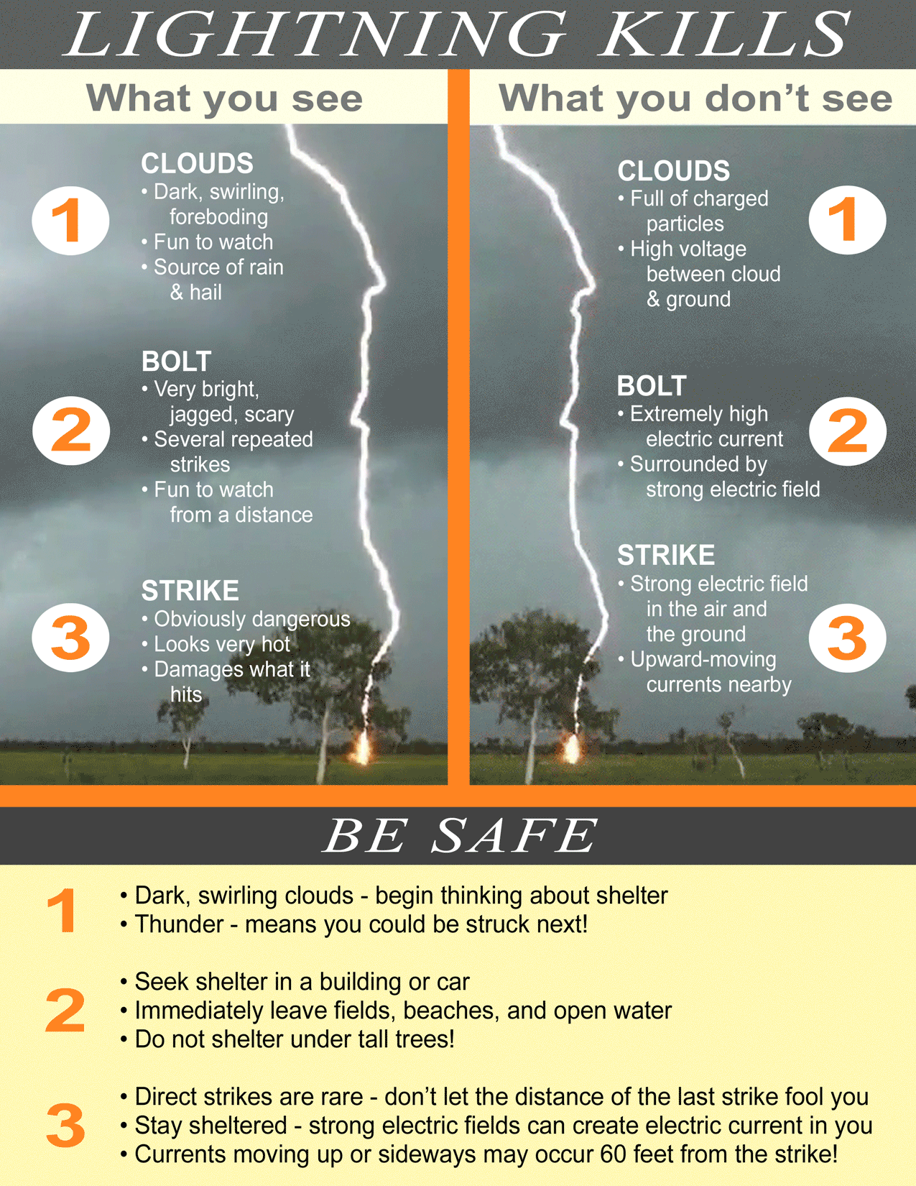
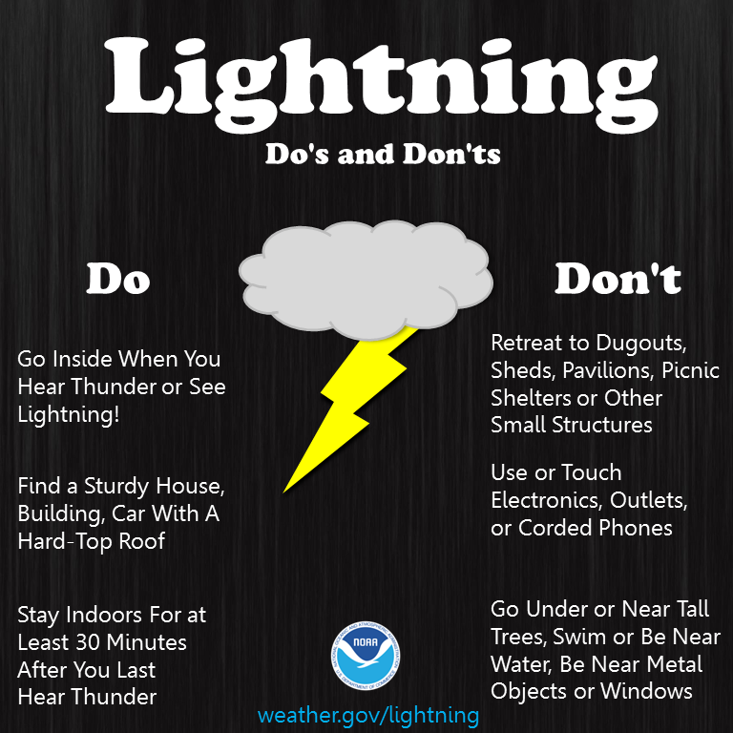

Slide 10
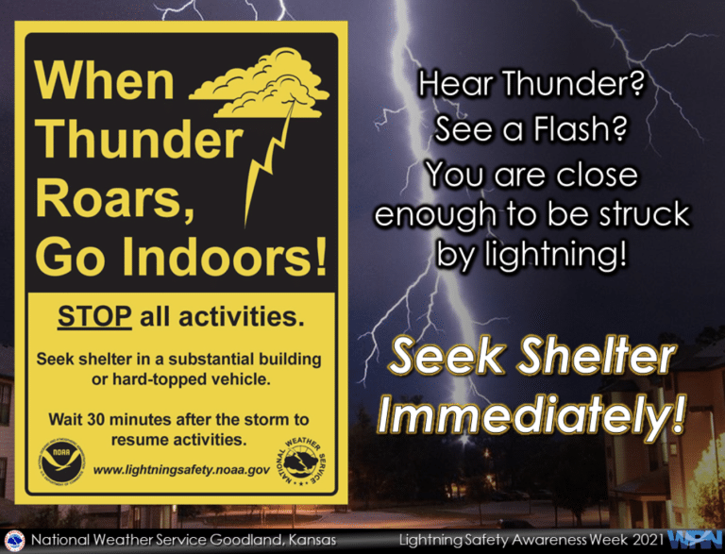

Slide 11
Faulty Equipment
Faulty Equipment is any type of mechanical or electric equipment that is dangerous or unsafe to use.
Most common types:
Forklifts;
Dump trucks;
Bladed tools, such as power saws;
Nail guns;
Pressurized gas containers;
Conveyor belts;
Power presses;
Ladders;
Scaffolding;
Power tools;
Manufacturing equipment; and
Work vehicles.

Slide 12
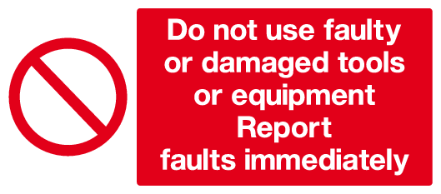

Slide 13
Working on Energized Equipment
Only designated and qualified Sunrise employees may work on or with exposed energized lines or parts of equipment.
Only designated and qualified Sunrise employees may work in areas containing unguarded, uninsulated energized lines or parts of equipment operating at 50 volts or more.

Slide 14
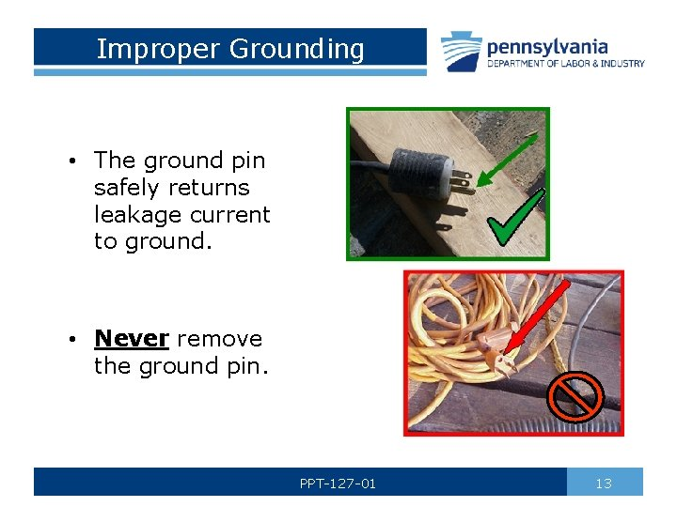
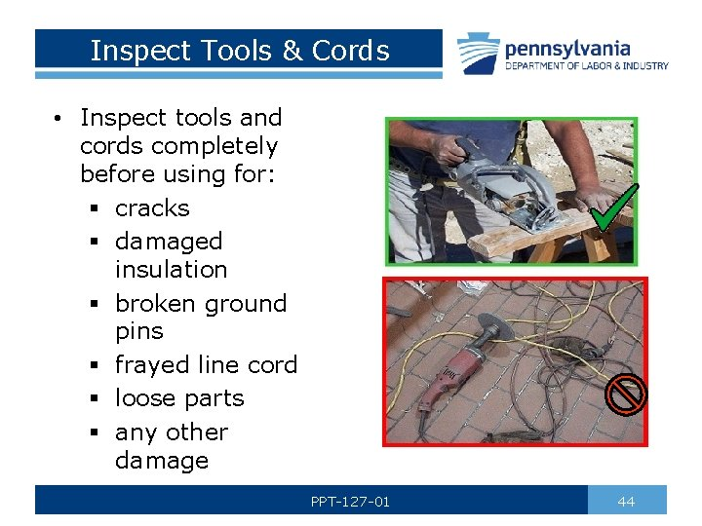

Slide 15
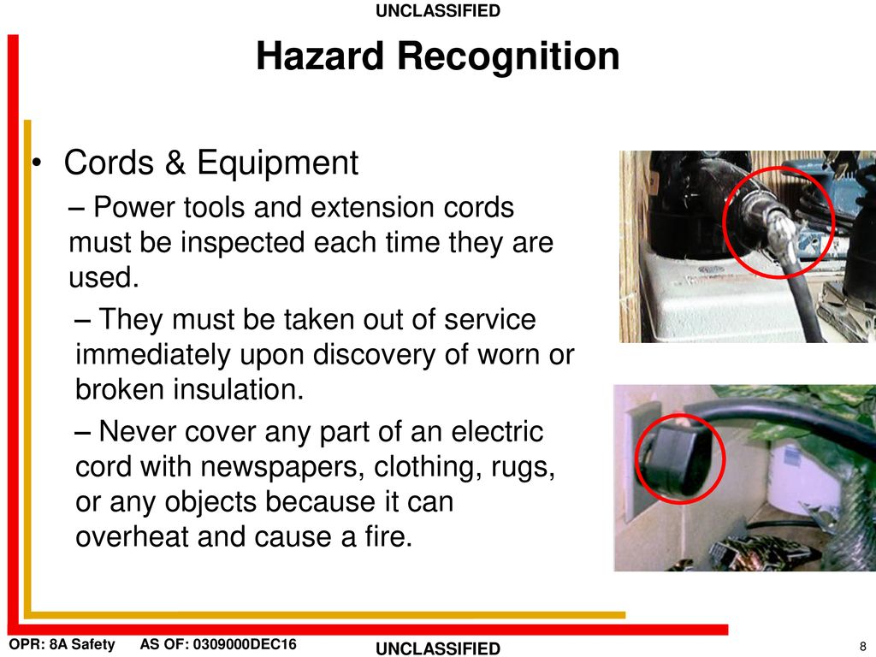

Slide 16
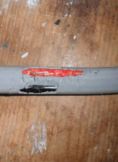
Damaged Insulation
Rubber is used as insulation for the current-carrying conductors of most electrical appliances.
Rubber insulation is prone to damage due to regular bending and twisting during use. The rubber insulation might break apart and expose the wire.
This damaged insulation would result in:
Electric shock—resulting in serious injury or even death to users.
Short circuit in the current path by connecting exposed current –carrying conductors together – resulting in the wires heating up, which could lead to fire.

